Slide 1
IEEE Xplore AI Research Suite
User Guide

Slide 2
Accelerate Your Research and Gain New Insights with…
The NEW IEEE Xplore AI Research Suite
IEEE Xplore AI Research Suite provides a new set of AI-powered features that enhance a user’s experience with IEEE Xplore.
These features allow users to easily search and discover articles of interest from IEEE
and other STEM publishers, accelerate their understanding of individual papers, and gain new insights.
Now available as an optional
subscription upgrade for IEL subscribers.

Slide 3

IEEE Xplore AI Research Suite
The ONLY AI research assistant that leverages both the full-text and metadata of IEEE’s peer-reviewed journal articles and conference papers, with an engine specifically tuned to IEEE content to deliver higher quality results.
In recent benchmarking tests*, IEEE Xplore AI Overview responses generated from full-text and abstracts vastly outperformed abstract-only responses.
Why is this important?
Quality of Results: Scored 3X greater in quality of results across every key metric*
Comprehensive Coverage: Finds relevant information buried deep in the text that may not be covered in the title or abstract
Contextual Relevance: Allows searching for phrases or specific context within the body of a document
Increased Comprehension: Provides deeper detail to cover all aspects of the user question
* Benchmarking results as evaluated by a judge LLM in an LLM-as-a-judge evaluation

Slide 4
Key Benefits of IEEE Xplore AI Research Suite
          Time Savings and Increased Comprehension
          Trusted Content
          Comprehensive Coverage
          Verifiable Results
          User-Friendly Interface

Slide 5
Key Benefits of IEEE Xplore AI Research Suite
Time Savings and Increased Comprehension: Discover new insights faster with IEEE Xplore AI. Quickly understand more about your topic with the IEEE AI Overview and AI Article Summaries.
Trusted Content: The only AI research assistant that allows users to search both the full-text and metadata of IEEE’s peer-reviewed journal articles and conference papers.
Comprehensive Coverage: AI Search also provides access to an extensive range of STEM metadata from journal articles and conference papers. The selection is expertly curated to include scholarly articles in STEM, without the typical noise in other tools.
Verifiable Results: AI overviews reference the source documents to ensure you can quickly and easily verify and trust the answers provided.
User-Friendly Interface: Allows users to input freeform semantic queries while also providing smart keyword suggestions to refine search terms.

Slide 6
IEEE Research Navigator
Powered by IEEE Xplore AI

Slide 7
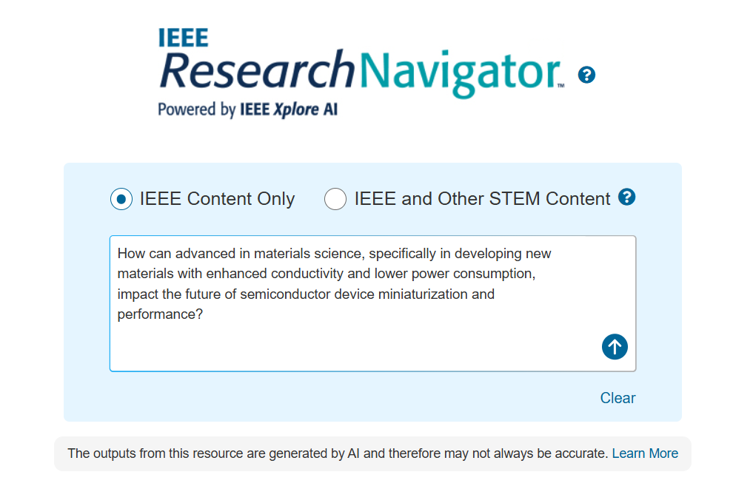
IEEE Research Navigator
IEEE Research Navigator, powered by IEEE Xplore AI, provides an advanced query tool for journal articles and conference papers published by IEEE.
This technology also includes a database of other publishers focused on STEM-related fields of study—all in one place.
Notes:
Time Savings and Increased Comprehension: Discover new insights faster with IEEE Xplore AI. Quickly understand more about your topic with the IEEE AI Overview and AI Article Summaries.
Trusted Content: The only AI research assistant that allows users to search both the full-text and metadata of IEEE’s peer-reviewed journal articles and conference papers.
Comprehensive Coverage: AI Search also provides access to an extensive range of STEM metadata from journal articles and conference papers. The selection is expertly curated to include scholarly articles in STEM, without the typical noise in other tools.
Verifiable Results: AI overviews reference the source documents to ensure you can quickly and easily verify and trust the answers provided.
User-Friendly Interface: Allows users to input freeform semantic queries while also providing smart keyword suggestions to refine search terms.

Slide 8
Key Benefits of IEEE Research Navigator
Time Savings: Quickly understand more about your topic with the IEEE AI Overview and AI Article Summaries.
Coverage: AI Search provides access to an extensive range of STEM metadata from journal articles and conference papers. While the search is broader than the typical IEEE Xplore search, the selection is curated to scholarly articles in STEM, without the typical noise of other tools.
User-Friendly Interface: As users type their searches, the system gives smart keyword suggestions to quickly refine their search terms. It allows users to input freeform semantic queries, tailoring the search process to individual research needs.

Slide 9
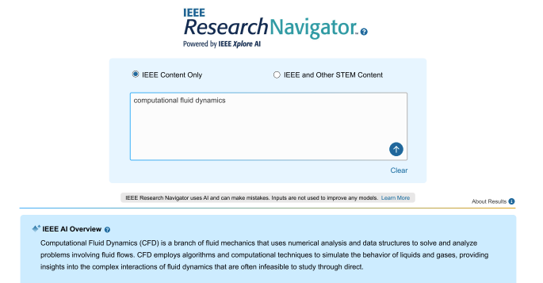
IEEE Research Navigator
AI powered search/summarization going beyond traditional keyword search
Users can execute a free-form search and get a summary and links to most relevant articles by understanding the intent and meaning of queries
Learn quickly about the query topic with the IEEE AI Overview and gain insights into the content of an article with AI Article Summaries
Discover highly relevant journal articles and conference papers from both IEEE and other STEM publishers, covering Computer Science, Engineering, Mathematics, Material Science, and Physics
Notes:
Time Savings and Increased Comprehension: Discover new insights faster with IEEE Xplore AI. Quickly understand more about your topic with the IEEE AI Overview and AI Article Summaries.
Trusted Content: The only AI research assistant that allows users to search both the full-text and metadata of IEEE’s peer-reviewed journal articles and conference papers.
Comprehensive Coverage: AI Search also provides access to an extensive range of STEM metadata from journal articles and conference papers. The selection is expertly curated to include scholarly articles in STEM, without the typical noise in other tools.
Verifiable Results: AI overviews reference the source documents to ensure you can quickly and easily verify and trust the answers provided.
User-Friendly Interface: Allows users to input freeform semantic queries while also providing smart keyword suggestions to refine search terms.

Slide 10

Accessing IEEE Research Navigator from IEEE Xplore
The IEEE Xplore AI Research Suite tools are appended to your IEL subscription, so you must log in with your institutional credentials to access them. Upon successful login, you will see an AI Search button beneath the search bar on the homepage.

Slide 11
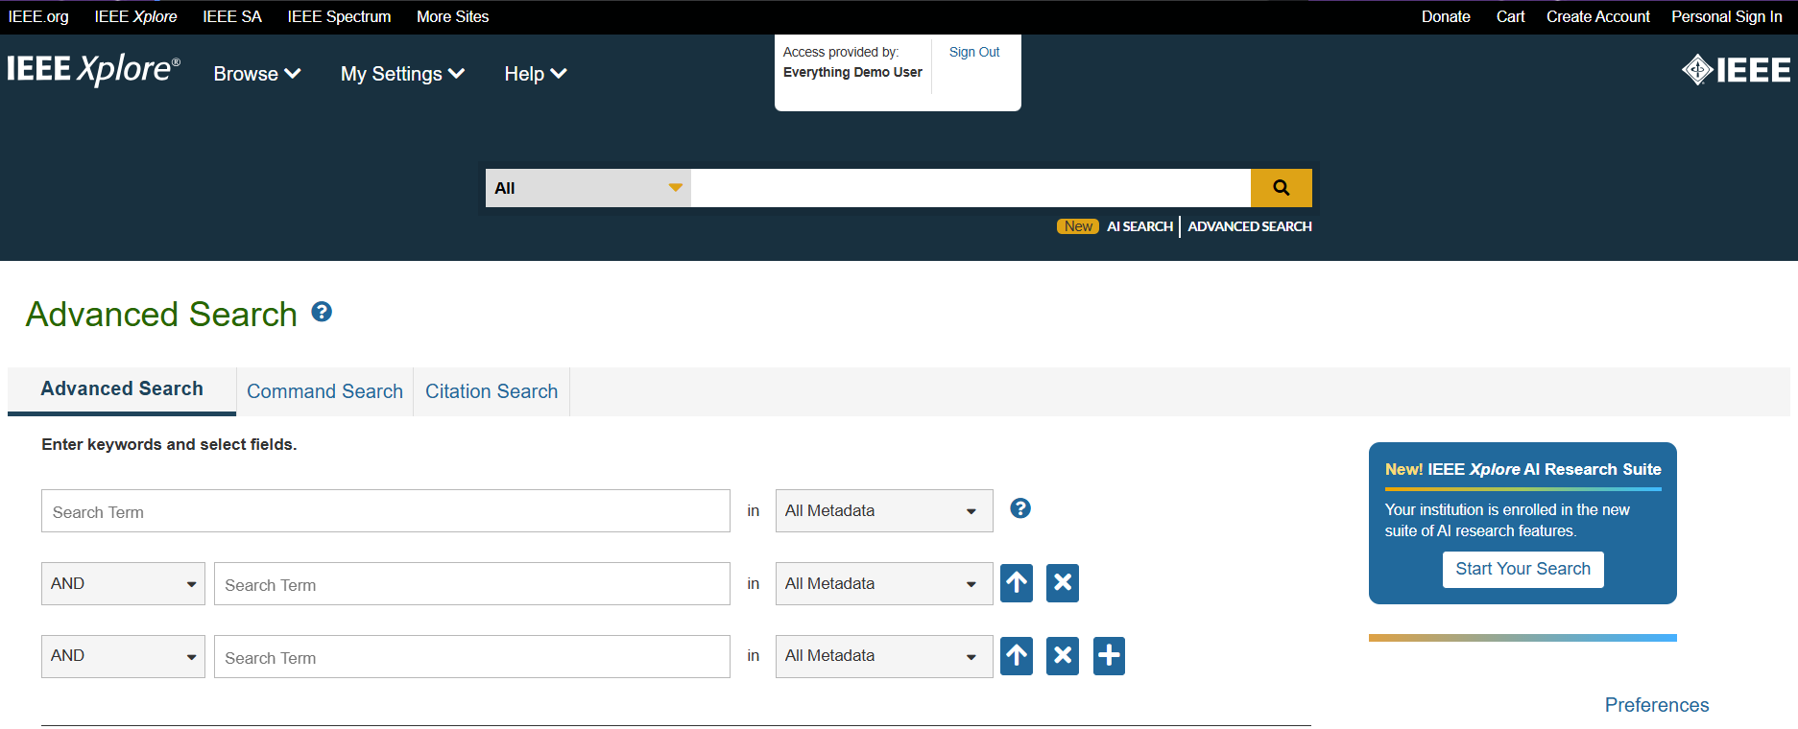
Accessing IEEE Research Navigator from IEEE Xplore
Alternatively, you can click on
“AI Search” from the global header or select the link from Advanced Search.

Slide 12
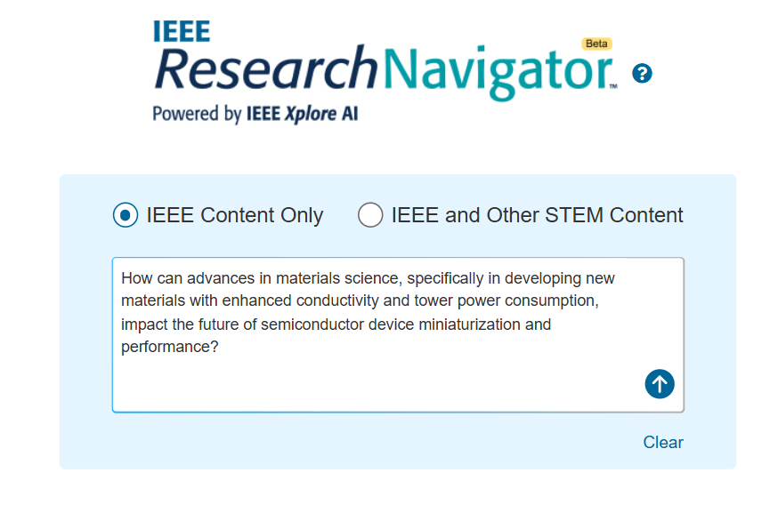

Initiating a Search from IEEE Research Navigator
From the IEEE Research Navigator page, you can search IEEE content only or expand your search to other STEM content that has been indexed.
You can begin your search by leveraging the large search box provided.

Slide 13
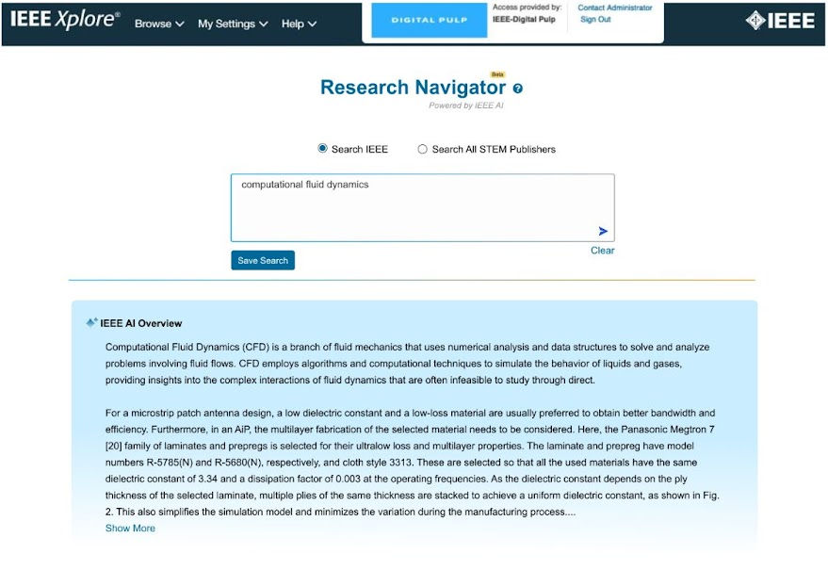
IEEE Research Navigator
IEEE AI Overview
At the top of the search results, a panel called “IEEE AI Overview” shows the IEEE Xplore AI response to the user query.
This AI article summary is dynamically generated using content extracted from the top search results, which are ranked by relevance and aims to directly address the user’s query.

Slide 14
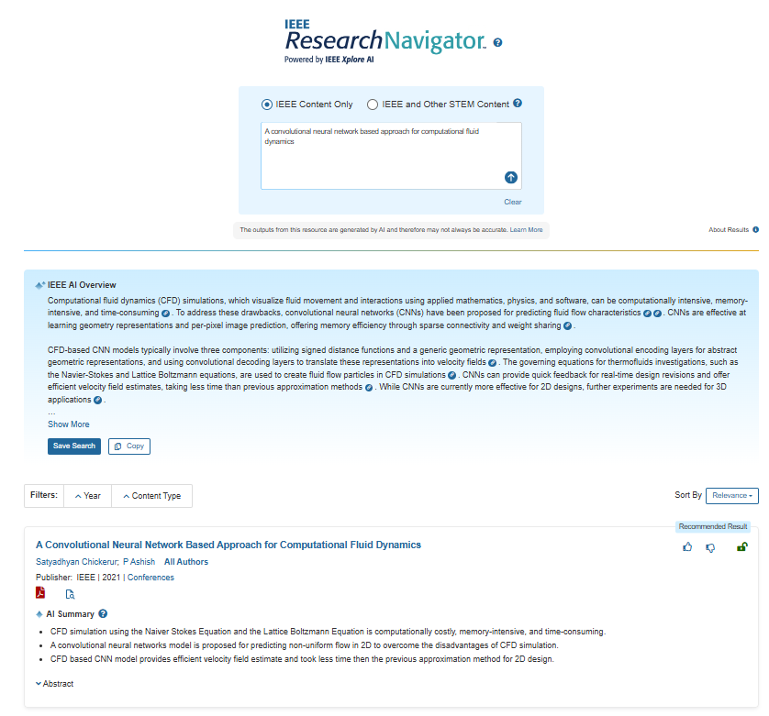
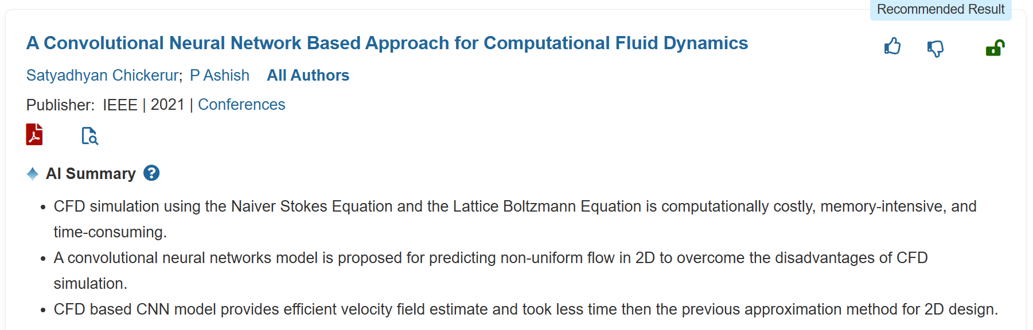
IEEE Research Navigator
AI Article Summaries
Under each search result, an AI-generated article summary is available.
Each Summary shows three key points of the article derived from the full-text and abstract.
The AI article summary provides a short synopsis of the article so that the user can quickly understand why the article was retrieved and decide whether to continue to the full article.

Slide 15
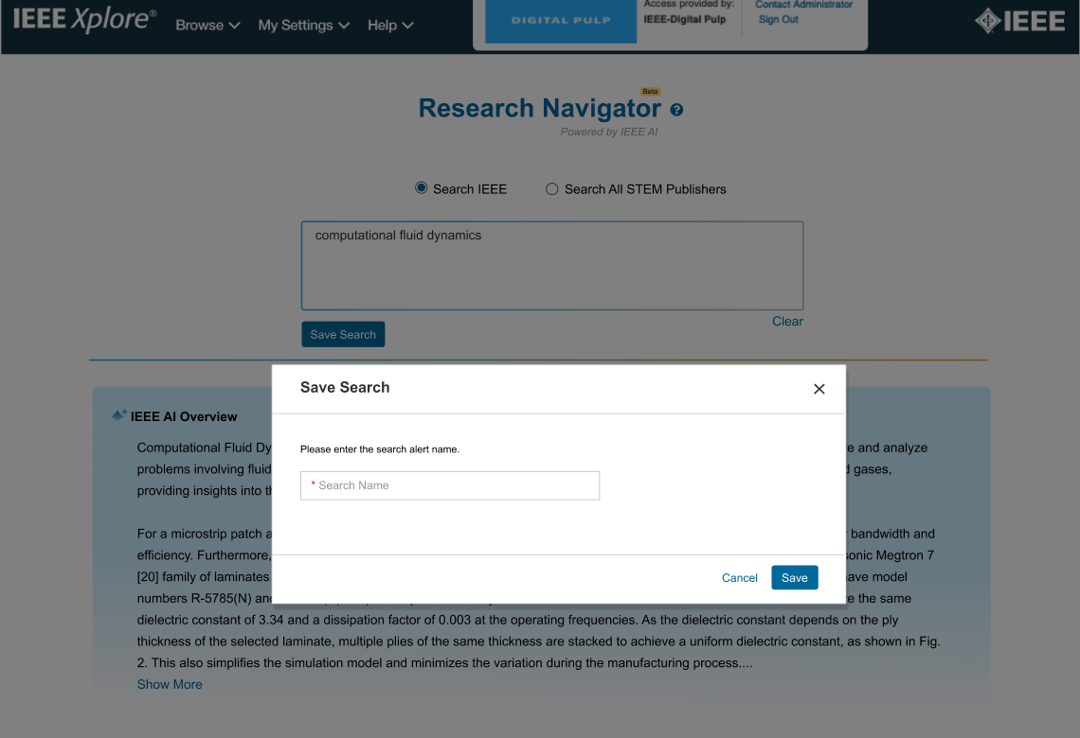

IEEE Research Navigator
Saved Search
Search queries can be saved so that users can access them at a later time, if needed.
This helps save time and improves research efficiency.

Slide 16
IEEE Reading Lens
Powered by IEEE Xplore AI

Slide 17
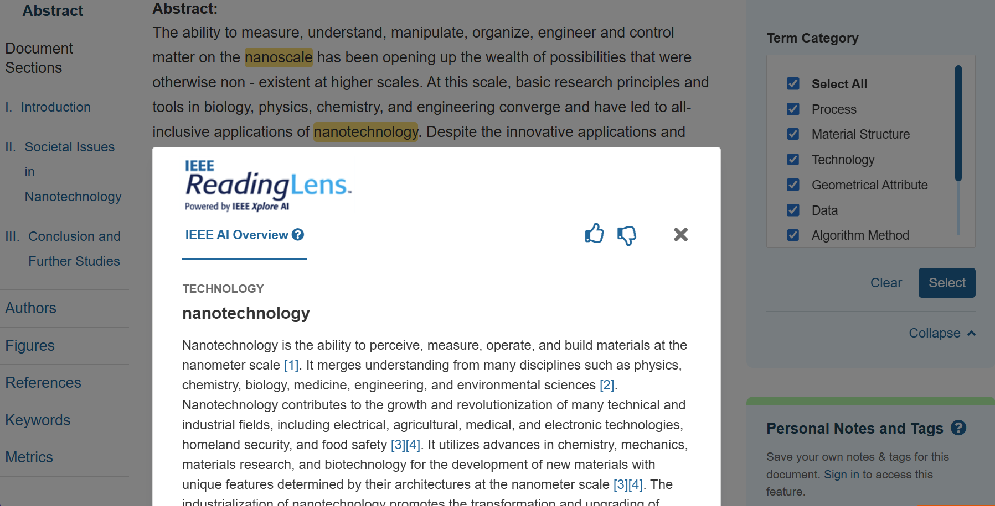
IEEE Reading Lens
Accelerates reading and understanding of articles by highlighting and contextually defining terms within abstracts and full-text
View term definitions to learn more about a concept without the need for external web browsing while reading an article
Terms are assigned into 30+ categories, such as Algorithms, Hardware, Programming Languages, and more, which can be used to filter content for enhanced discoverability
Notes:
Time Savings and Increased Comprehension: Discover new insights faster with IEEE Xplore AI. Quickly understand more about your topic with the IEEE AI Overview and AI Article Summaries.
Trusted Content: The only AI research assistant that allows users to search both the full-text and metadata of IEEE’s peer-reviewed journal articles and conference papers.
Comprehensive Coverage: AI Search also provides access to an extensive range of STEM metadata from journal articles and conference papers. The selection is expertly curated to include scholarly articles in STEM, without the typical noise in other tools.
Verifiable Results: AI overviews reference the source documents to ensure you can quickly and easily verify and trust the answers provided.
User-Friendly Interface: Allows users to input freeform semantic queries while also providing smart keyword suggestions to refine search terms.

Slide 18

IEEE Reading Lens
Highlight
Toggle Panel
A panel on the side of the page allows the user to browse the available categories, filter highlighted terms by category, or turn off the highlighting for all terms.

Slide 19
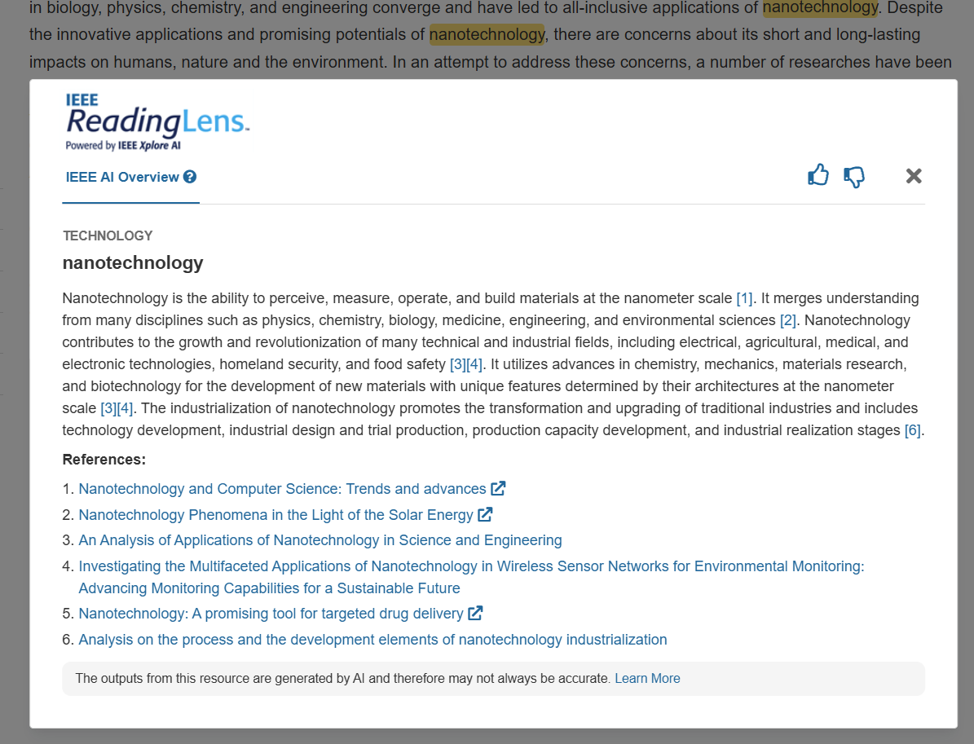
IEEE Reading Lens
Highlighted Key Terms –
AI definition
For each highlighted keyword, an
AI generated definition is derived from the IEEE Large Language Model (IEEE LLM) trained on the IEEE articles.
Six references will be provided
at the end of the generated text as well, so that the users can read the source material.

Slide 20
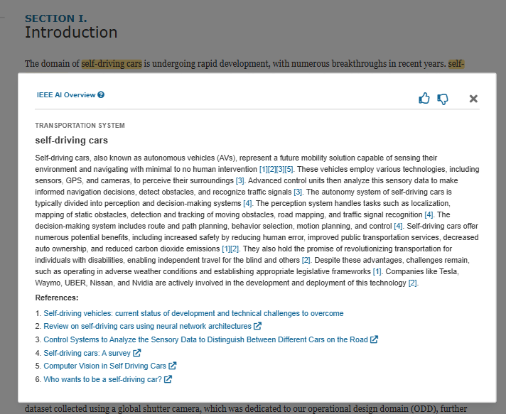
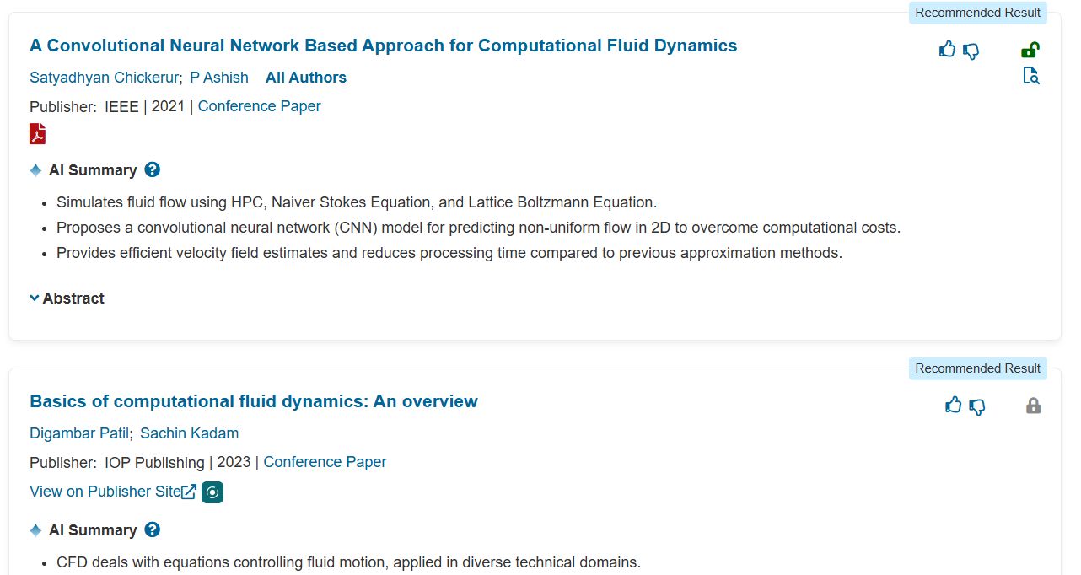
Navigating to IEEE Reading Lens
Click on the document title from the search results page of Research Navigator to open Reading Lens.
Reading Lens available for IEEE content.
A subset of IEEE documents that do not have Reading Lens terms will link to the abstract page.

Slide 21
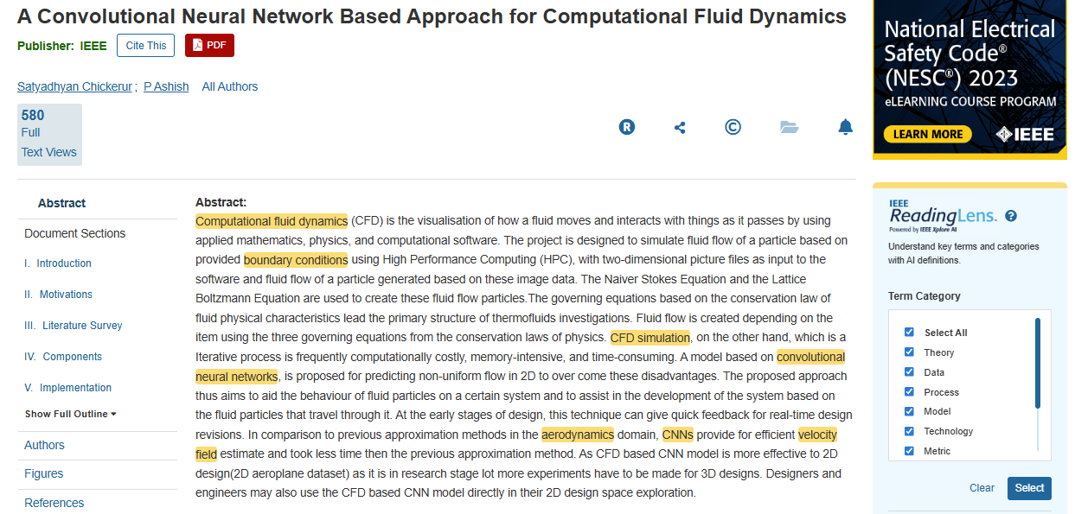
Navigating to IEEE Reading Lens

Slide 22
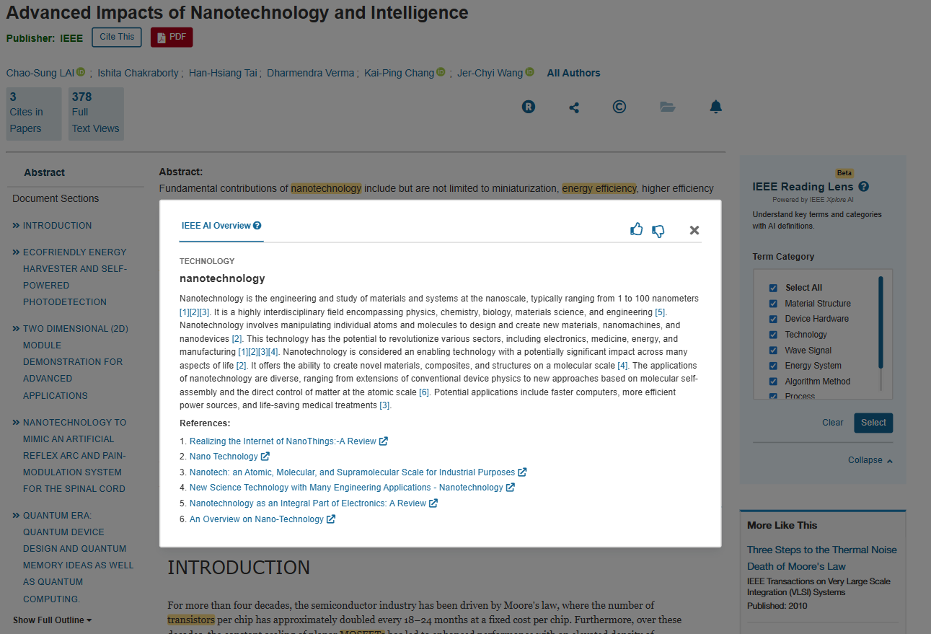
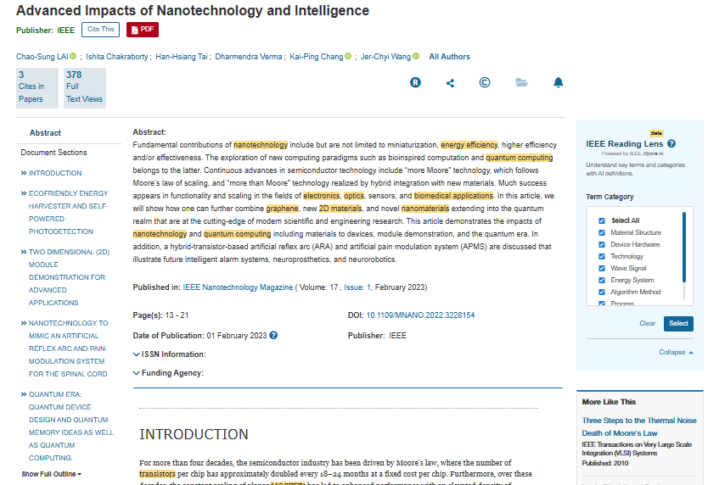
IEEE Reading Lens
Accelerates reading and understanding of articles by highlighting and contextually defining terms within abstracts and full-text
View term definitions to learn more about a concept without the need for external web browsing while reading an article
Terms are assigned into 30+ categories, such as Algorithms, Hardware, Programming Languages, and more, which can be used to filter content for enhanced discoverability

Slide 23
Search Tips for Using the IEEE Xplore AI Research Suite

Slide 24
Search Tips for Using the
IEEE Xplore AI Research Suite

Slide 25
Keyword vs. AI Search
 | Keyword Search | AI (Vector) Search
Search Mode | Lexical | Semantic
Maximum Characters | 25 terms per clause | 4,000 characters
Wildcards | Up to 10 wildcards | Not applicable
Content Types | Periodicals, conferences, standards, books, courses | Periodicals & Conferences
Publishers | IEEE & Curated STEM Publishers | IEEE & STEM Publishers
Index | Metadata & Full-Text | Metadata & Full-Text
Year | 1884-Present | 2018-Present
Records | 6.85 Million | 9.5 Million

Slide 26
Keyword vs AI Search
Use Keyword Search For:
Use AI Search For:
Looking for exact matches on document title, abstract, etc.
Searching for something
very specific.
Entering structured lexical searches using wildcards and Boolean expressions.
Finding content based on semantic similarity.
When you do not have a clear idea of what looking for.
Discover articles with multiple variations of keywords and phrases.

Slide 27

Specific Search:
“Layered Analysis of Injury in the Rat Esophagus Induced by Photodynamic Therapy“
Keyword Search:
Keywords are processed as a phrase (assumes “AND” operator).
When 5-6 or more
keywords entered.
Focuses on literal matches
for keywords.
Only one result is returned
with an exact match.

Slide 28

Specific Search:
“Layered Analysis of Injury in the Rat Esophagus Induced by Photodynamic Therapy“
AI Search:
Focuses on fuzzy (approximate) matches using numerical embeddings (vectors).
Incorporates semantic and contextual understanding.
Returns a higher number of matches (30) than a keyword search.

Slide 29

Specific Search:
“System-level test, or SLT, is an increasingly important process step in today's integrated circuit testing flows. Broadly speaking, SLT aims at executing functional workloads in operational modes. In this paper, we consolidate available knowledge about what SLT is precisely and why it is used despite its considerable costs and complexities. We discuss the types or failures covered by SLT, and outline approaches to quality assessment, test generation and root-cause diagnosis in the context of SLT. Observing that the theoretical understanding for all these questions has not yet reached the level of maturity of the more conventional structural and functional test methods, we outline new and promising directions for methodical developments leveraging on recent findings from software engineering.“
Keyword Search:
Unable to process search.

Slide 30
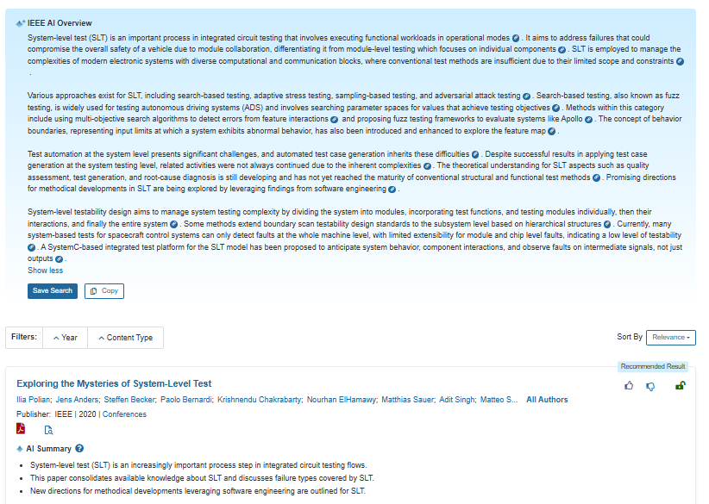
Specific Search:
“System-level test, or SLT, is an increasingly important process step in today's integrated circuit testing flows. Broadly speaking, SLT aims at executing functional workloads in operational modes. In this paper, we consolidate available knowledge about what SLT is precisely and why it is used despite its considerable costs and complexities. We discuss the types or failures covered by SLT, and outline approaches to quality assessment, test generation and root-cause diagnosis in the context of SLT. Observing that the theoretical understanding for all these questions has not yet reached the level of maturity of the more conventional structural and functional test methods, we outline new and promising directions for methodical developments leveraging on recent findings from software engineering.“
AI Search:
Returns AI overview and
semantically relevant results.

Slide 31
Functions Supported by Search Mode
 | Keyword Search | AI Search
Boolean Operators | ✅ | ❌
Wildcard Characters | ✅ | ❌
Fuzzy Matching | ❌ | ✅
Search Paragraphs | ❌ | ✅
Search Full-Text* | ✅ | ❌
Search Legacy Content* | ✅ | ❌

Slide 32
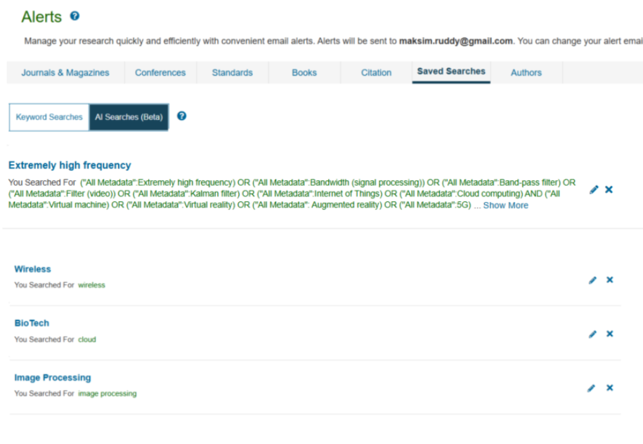
AI Saved Searches
Up to 15 AI searches can
be saved.
Alerting not available for
AI saved searches.
Available via
My Settings > Saved Searches.

Slide 33

Thank you!
Questions about the IEEE Xplore AI Research Suite?
Contact onlinesupport@ieee.org

